Slide 1
SCADA 101
ASHOK CHOKALINGAM

Slide 2
What is ICS? Industrial Control Systems
ICS is a general term that encompasses several types of control systems, including supervisory control and data acquisition (SCADA) systems, distributed control systems (DCS), and other control system configurations

Slide 3
What is scada?
A generic name for a computerized system that is capable of gathering and processing data and applying operational controls over long distances

Slide 4
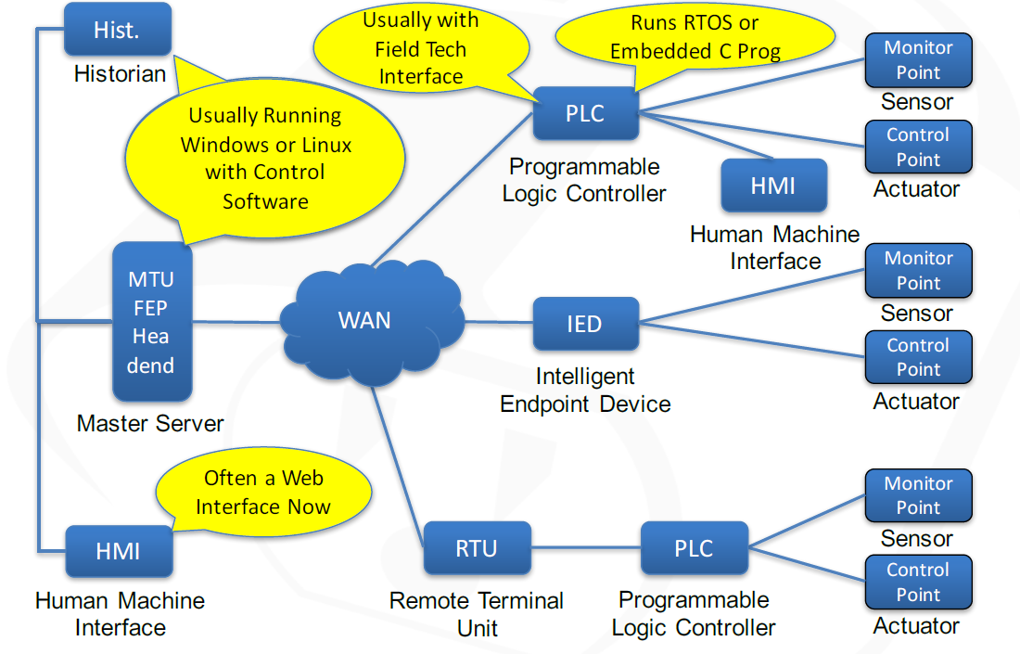
SCADA ARCHITECTURE

Slide 5
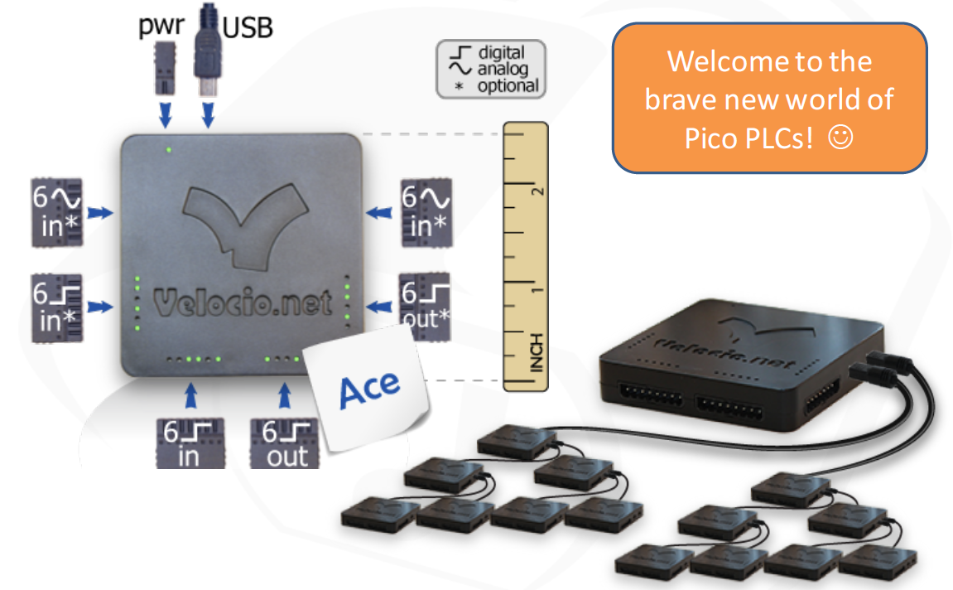
PLC

Slide 6
MODBUS
Developed by Modicon in 1979
Widely accepted protocol (implemented by hundreds of vendors) used in multiple industries
Master (HMI/FEP) to field (RTU, PLC, IED) communication
- Master station must pole the field device
- Field device cannot initiate communications
- Only a simple request/response protocol
Security is not part of the design

Slide 7
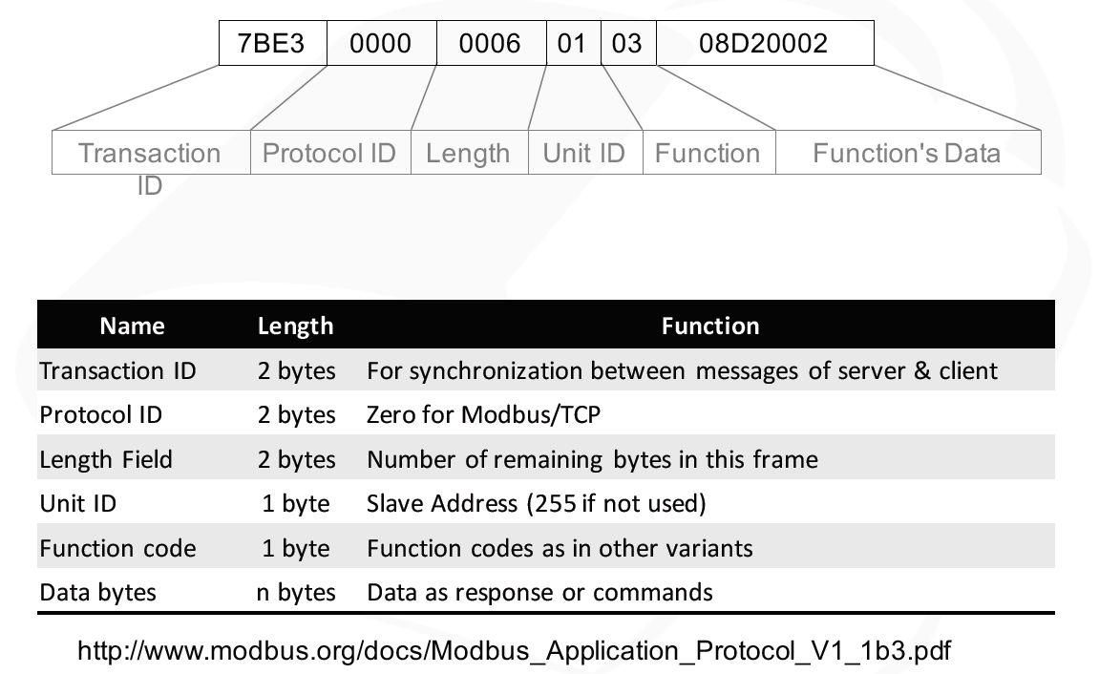
Modbus Deep Dive

Slide 8
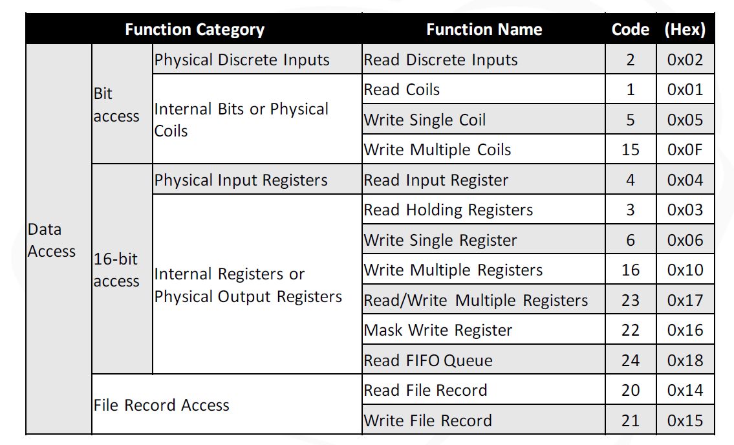
Modbus Data Function Codes

Slide 9
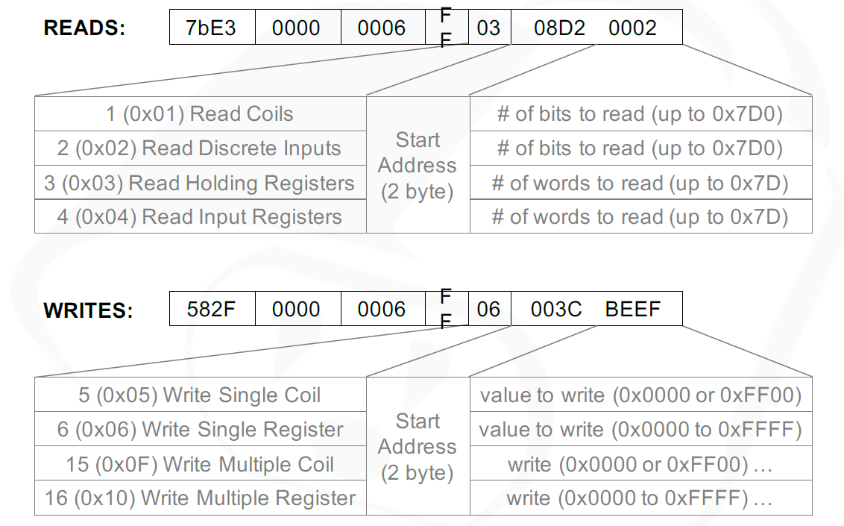
Common Modbus Functions

Slide 10
Modbus Capture Analysis
Capture Sample Source
https://www.cloudshark.org/captures/76038eaa4a3b

Slide 11
DEMO

Slide 12
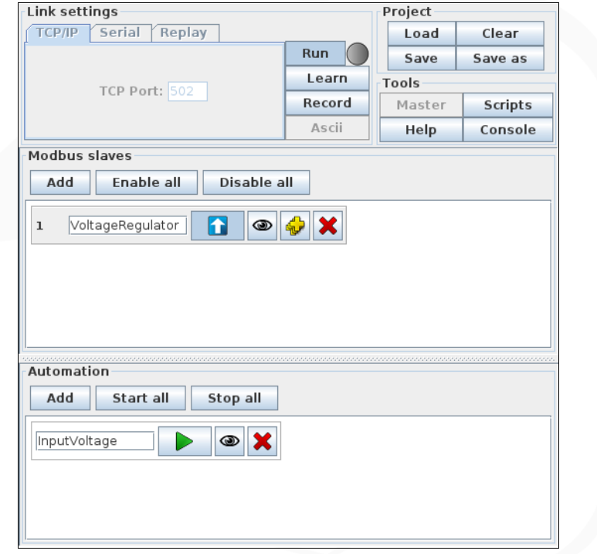
Voltage Regulator Simulation

Slide 13
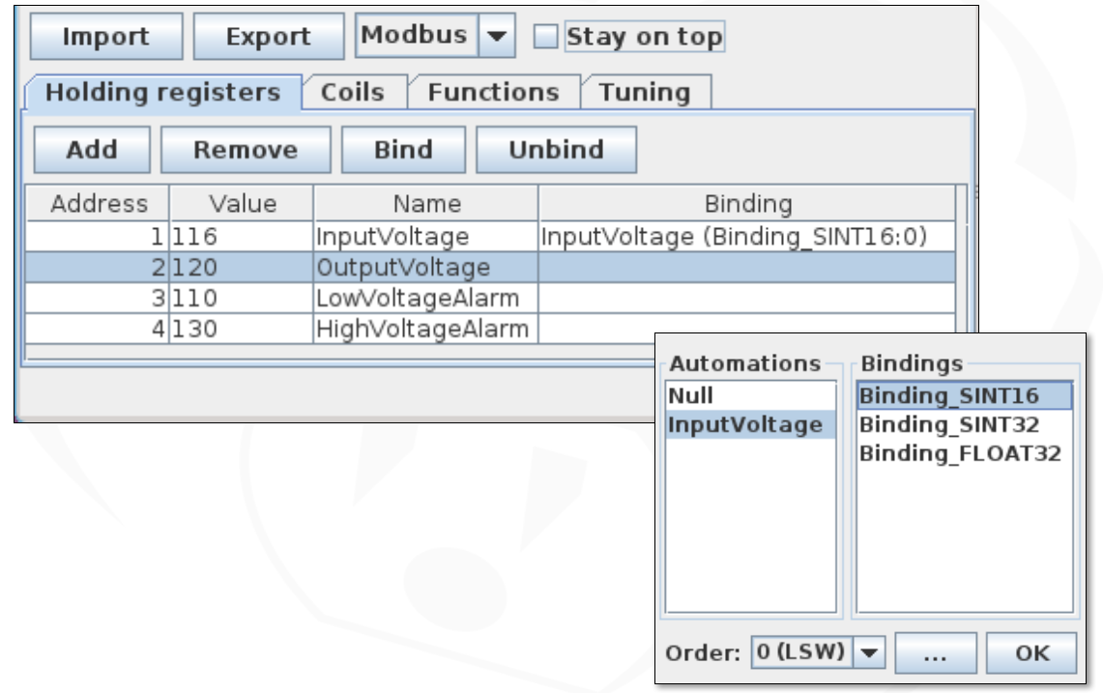
Configuring "Voltage Regulator" Slave

Slide 14
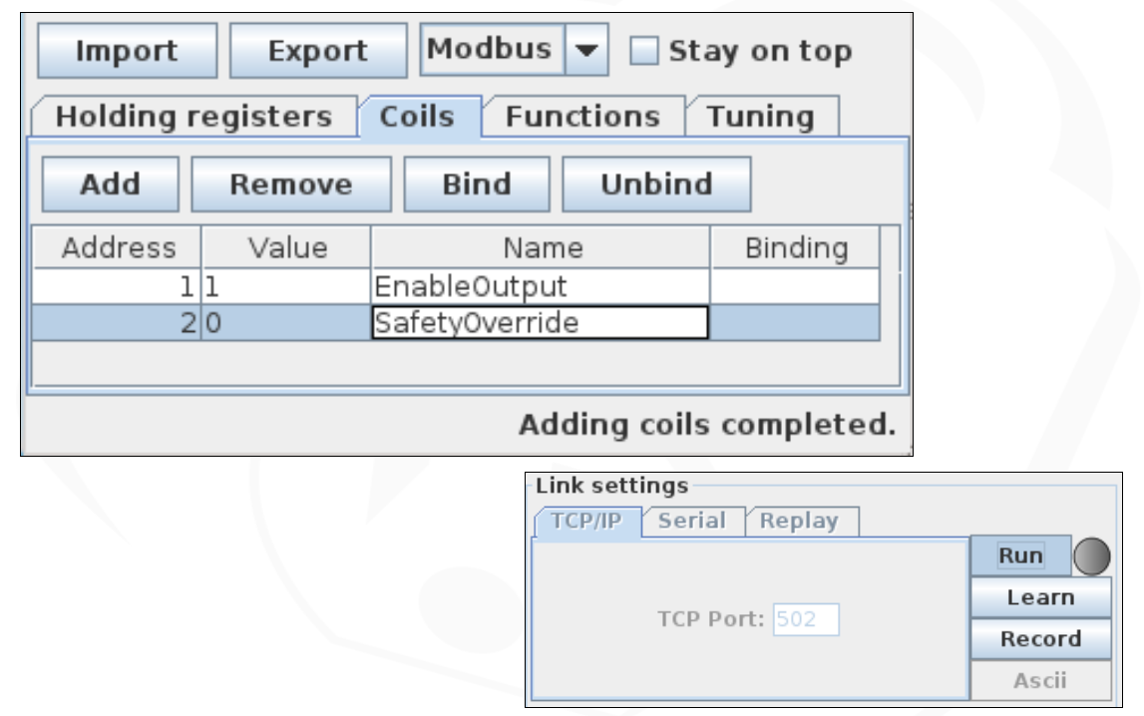
" Adding Coils to "Voltage Regulator"

Slide 15
THANK YOU

